Slide 1
Agenda
Block Chain Basics
How does it work?
Market Trends

Slide 2
Blockchain Overview
Blockchains are most useful when loosely coupled organizations want to share and audit information and automate mutually beneficial processes
Mike Jacobs

Slide 3






Blockchain may transform the internet of information to the internet of value
Digital Rights
Money
Information
Assets
Energy Credits
Votes
Deeds
Stocks
Send a copy
Send a copy?

Slide 4
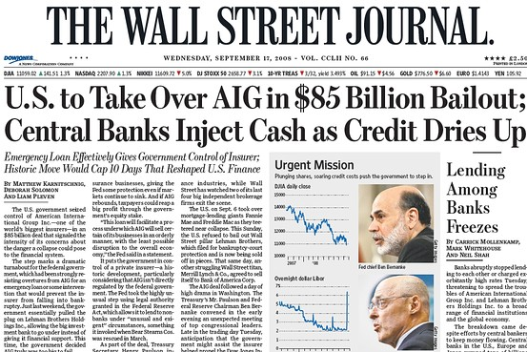
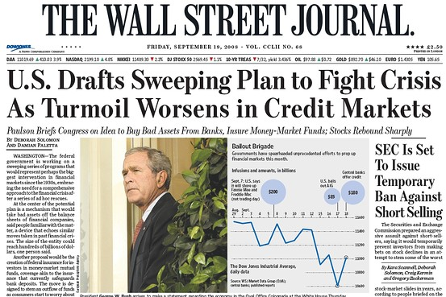
2008

Slide 5
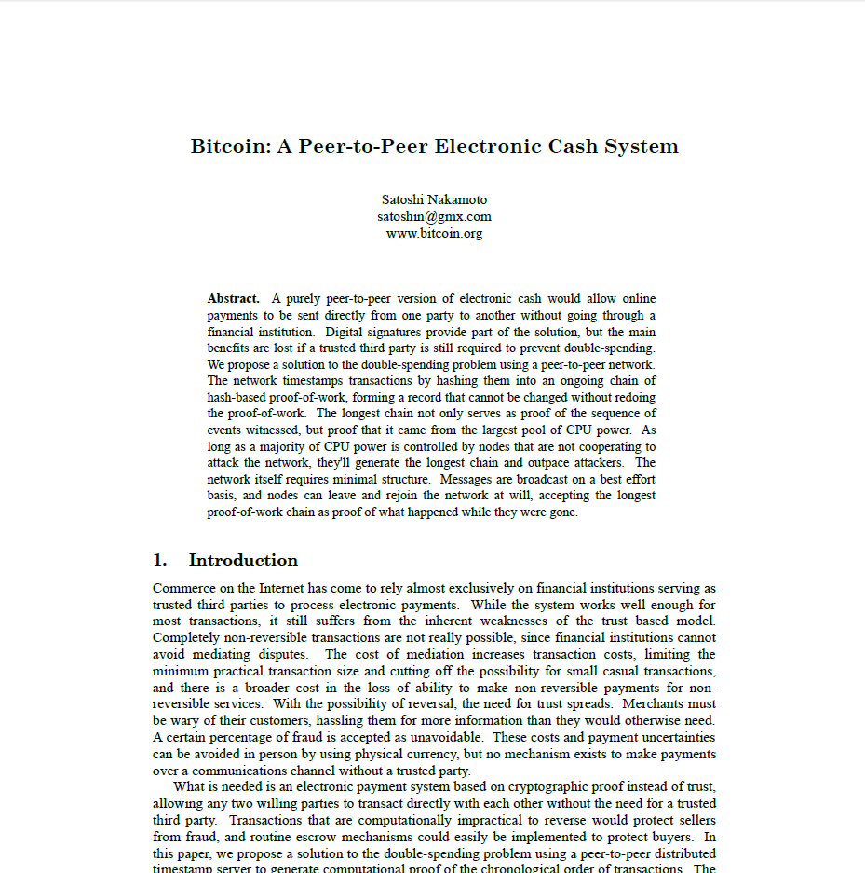
Bitcoin is Born
Distributed Ledger
Cryptographic hashing
Digital Signatures
Consensus validation
+
Blockchain
Blockchain
Virtual Currency
+
Bitcoin

Slide 6




Multi-Enterprise Arrangements – Current State
Legal Arrangement
Dissimilar interpretation
that cause reconciliations
Dissimilar interpretation
that cause reconciliations
Replicated and/or Opaque
Processes
Replicated
Processes
Many similar parties
Intermediaries
Audit Needs
Audit Needs
Data Silos
Data Replication
Data to Drive Contract
$ Processes
$ Transactions
$ Processes
Notes:
Blockchain is the public ledger technology used to drive Bitcoin transactions
Eliminates the need for intermediaries by enabling peer to peer transactions
Is highly available by replicating transactions across many networked computers
Tamper-proof through encryption and validation voting within the network
Transparent access to all transactions
Has potential to disrupt many areas:
Financial transactions by replacing intermediaries
Smart contracts that distribute money or other items of value based on events
Identity management such as passports, licenses, credentials
Transfer of anything of value

Slide 7
What is “Blockchain 1.0”?
Transactions of known, trusted parties
Transactions of unknown, untrusted parties
Potentially Impactful Business Transformation
Intermediary
Who are you?
Do you have it?
Double spending?
Examples: SWIFT, Escrow agents, HIE, Claims Clearinghouses, PBM
Blockchain is a decentralized, auditable, and immutable distributed ledger
Examples: Cryptocurrencies such as Bitcoin
Notes:
Blockchain is the public ledger technology used to drive Bitcoin transactions
Eliminates the need for intermediaries by enabling peer to peer transactions
Is highly available by replicating transactions across many networked computers
Tamper-proof through encryption and validation voting within the network
Transparent access to all transactions
Has potential to disrupt many areas:
Financial transactions by replacing intermediaries
Smart contracts that distribute money or other items of value based on events
Identity management such as passports, licenses, credentials
Transfer of anything of value

Slide 8
Types of Blockchains
Public
Consortium
Private
PRIVATE PROPERTY
Private Club
Members Only
NO
SOLICITING
LOITERING
TRESPASSING
ALL OFFENDERS WILL BE PROSECUTED TO THE FULL EXTENT OF THE LAW
Public Ledger
Unknown & untrusted participants
Open consensus process
Permissioned Ledger
Known & trusted participants
Designated consensus process
Permissioned Ledger
Known & trusted participants
Custom consensus process

Slide 9



How Does a “Blockchain 1.0” Work for Bitcoin?
1
2
3
4
Transaction is proposed to the network
Transactions are grouped into Blocks
Competition to validate the Block and earn an incentive
Blocks are securely chained together
50 BTC
Transaction 121
Transaction 122
Transaction 123
Transaction 124
Timestamp
Everyone is identified with a digital identity like a fingerprint
Identity is pseudo anonymous
Asset ownership is verified before proposed to network
Transactions are queued by computerized accountants
Pending transactions are grouped into blocks based on timeframe
Computerized accountants solve a hard crypto puzzle
First one to solve it earns an financial reward
Solution is easy to verify and consensus voting verifies validity of the block
Blocks are distributed to all nodes in the network
Blocks are securely linked together forming an immutable audit trail

Slide 10
Blockchain by Example: Transferring money
Alex
Bob
Alex owes Bob $100

Slide 11
Intermediaries & the Cost of Reconciliation
Alex’s Ledger
Bob’s Ledger
Intermediary
-$100
+$100
Alex
Bob
3 days to settle

Slide 12
What if there was a single ledger to reduce reconciliation?
Shared Ledger
-$100
+$100
Alex
Bob

Slide 13




And what if it was tamper proof? And resilient to failures?
Public Blockchain
… with secure transactions validated thru consensus
?
?
?
Alex
Bob
?
?
A shared, distributed anonymous ledger
?
Notes:
Open consensus

Slide 14
What are the benefits of Blockchain?
Transaction Source of Truth
Faster end-to-end transactions
Tamper-proof history of transactions
Increased accuracy
Reduced opportunity for fraud
Increased resiliency and availability
Improved cross-entity efficiency
Reduced human errors
Higher transaction rates
Increased security
Flexible validation methods
Distributed Ledger
Cryptographic hashing
Digital Signatures
Consensus validation
2008
+
Blockchain 1.0
2015
Blockchain 1.0
Consortiums
Smart Contracts
+
Blockchain 2.0
2017
Blockchain 2.0
Permissions
+
Blockchain 3.0

Slide 15
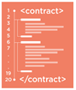


Multi-Enterprise Arrangements – Conceptual Blockchain Future State
Blockchain
Shared Data and Interpretation
Reduced
Process Burden
Competitors cooperate within consortiums with aligned incentives
Simplified Audit
Notes:
Blockchain is the public ledger technology used to drive Bitcoin transactions
Eliminates the need for intermediaries by enabling peer to peer transactions
Is highly available by replicating transactions across many networked computers
Tamper-proof through encryption and validation voting within the network
Transparent access to all transactions
Has potential to disrupt many areas:
Financial transactions by replacing intermediaries
Smart contracts that distribute money or other items of value based on events
Identity management such as passports, licenses, credentials
Transfer of anything of value

Slide 16
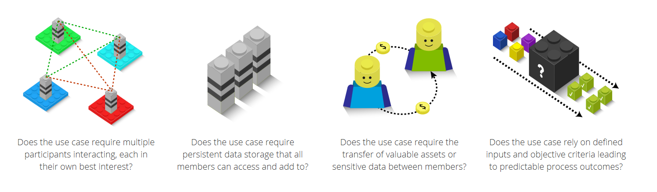
When to use Blockchain
Blockchains are most useful when loosely coupled organizations want to share and audit information and automate mutually beneficial processes
Who
Who participates?
Who validates blocks?
What
What is stored ‘on-chain’?
What is stored ‘off-chain’?
Why
Participant incentives?
Validator incentives?
Are incentives aligned?
How
How are smart contracts used?
Is there a compelling ROI?
Based in part on an image at http://rubixbydeloitte.com/education.html

Slide 17
Questions?
Q
A

Slide 18
What is a Blockchain and how does it work?

Slide 19
Types of Blockchains
Public
Consortium
Private
PRIVATE PROPERTY
Private Club
Members Only
NO
SOLICITING
LOITERING
TRESPASSING
ALL OFFENDERS WILL BE PROSECUTED TO THE FULL EXTENT OF THE LAW
Public Ledger
Unknown & untrusted participants
Open consensus process
Permissioned Ledger
Known & trusted participants
Designated consensus process
Permissioned Ledger
Known & trusted participants
Custom consensus process

Slide 20


Technical Example Bitcoin Blockchain Transaction
Pending Transactions
Alice
Bob
Transaction 131
Transfer 50 Bitcoins
Transaction 132
Transaction 134
Transaction 133
Vk_{A}
Vk_{B}
Transaction 134
Sk_{A}
Sk_{B}
Inputs
25 B, Vk_{A}
25 B, Vk_{A}
Transaction posted to network
Alice
20 B, Vk_{A}
20 B, Vk_{A}
Validation Nodes act as computer accountants
20 B, Vk_{A}
20 B, Vk_{A}
65 B
Bob
Outputs
Current balances are maintained in the unspent transaction output or UTXO
50 B, Vk_{B}
14 B, Vk_{A}
Vk_{X} – Public verification key for X
Sk_{X} – Private secret key for X
64 B + 1 B Transaction fee

Slide 21
Technical Structure of a Blockchain
Hash Results
4
2
1
Block 10
Block 11
Block 12
Reference to #9
Reference to #10
Reference to #11
3
Transaction 101
Transaction 111
Transaction 121
Transaction 102
Transaction 112
Transaction 122
Hash
Transaction 103
Transaction 113
Transaction 123
Transaction 104
Transaction 114
Transaction 124
Tx A
Tx
B
Tx
C
Tx
D
Timestamp 10
Timestamp 11
Timestamp 12
1
Transactions are grouped into a block
Integrity: Valid blocks cannot be inserted into the chain without decrypting and encrypting all previous blocks
2
Transactions are pair-wised hashed into a Merkle Tree
3
Blocks refer to hash of previous block in chain
4
Blocks are verified and voted on by validation nodes

Slide 22
Imagine the Private Healthcare “Blockchain 3.0” Possibilities
Bank
Features
Possibilities
Unique Digital Identities
Shared Single Source of Truth
Private and Secure
Automated Contracts
Healthcare Consortium
Personal Health Record
Automated ACO Quality $ Payout
“Super” Exchanges
Coordination of Benefits
Fraud Detection
Care Coordination
Patient
Care Coordinator
Clinical
Admin
Financial
Primary Care
Provider
Primary Payer
Automated Contracts
Specialist
Secondary Payer
Reference Labs
Notes:
A secure, permissioned, single source of truth for all stakeholders to improve access to consistent information

Slide 23
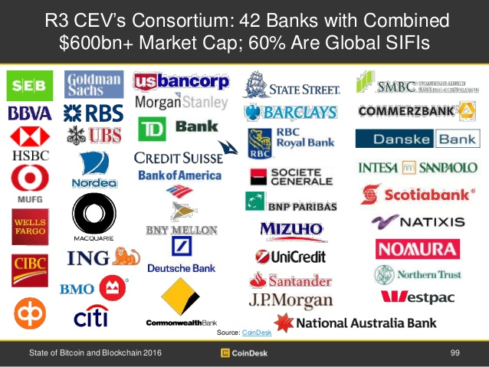

Financial Industry
Substantial cost savings
Competitive risk mitigation
Forming partnerships
Running pilots
SIFI = Systematically Important Financial Institutions

Slide 24
Is Blockchain being used outside of the financial industry?

Slide 25
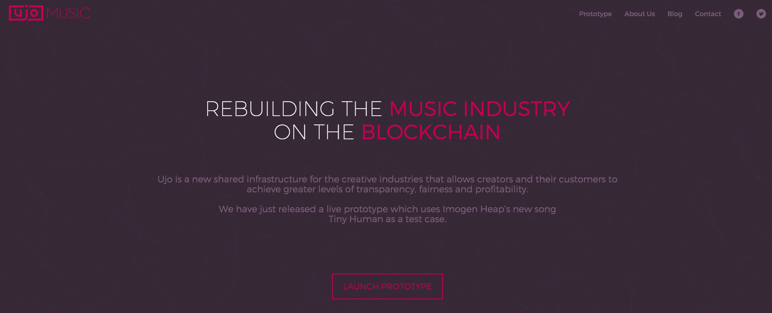
Music Digital Rights

Slide 26

Legal: Sign and Notarize Contracts, Validate Diplomas

Slide 27
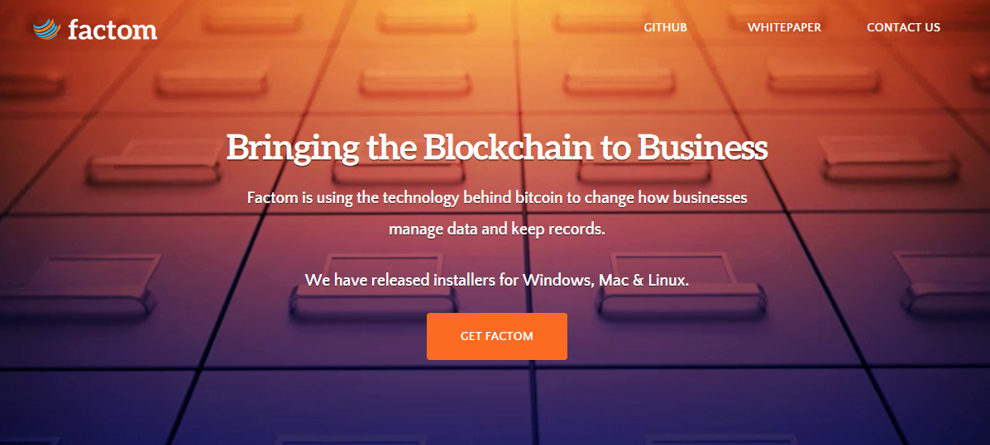
Records Management: Track Land Ownership

Slide 28
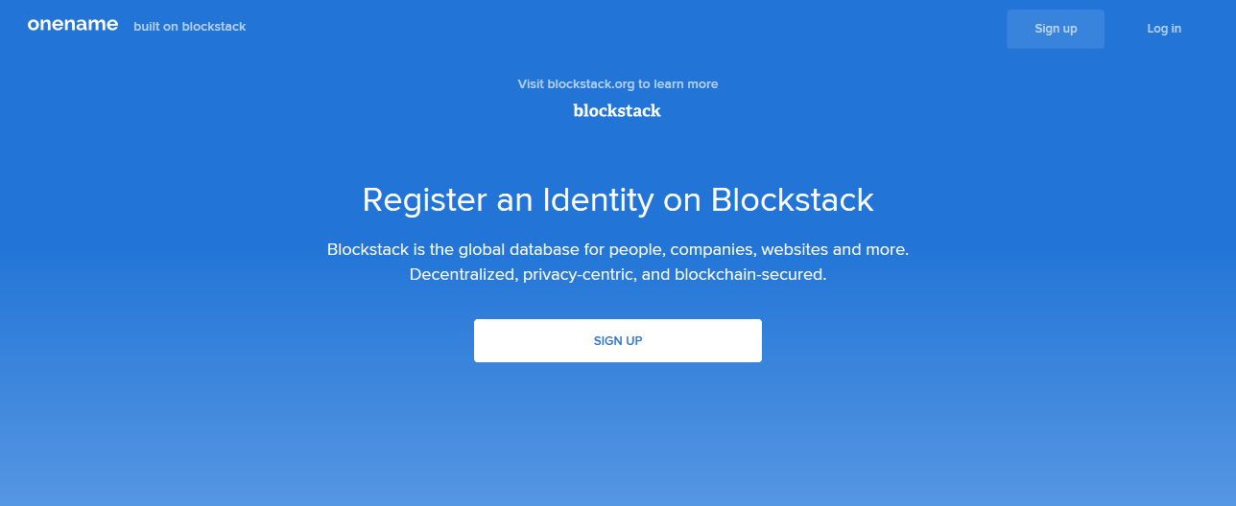
Digital Identity

Slide 29
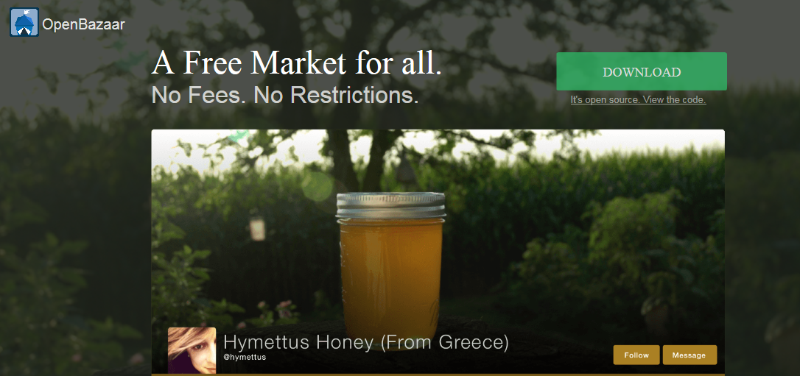
Small Business Marketplace

Slide 30
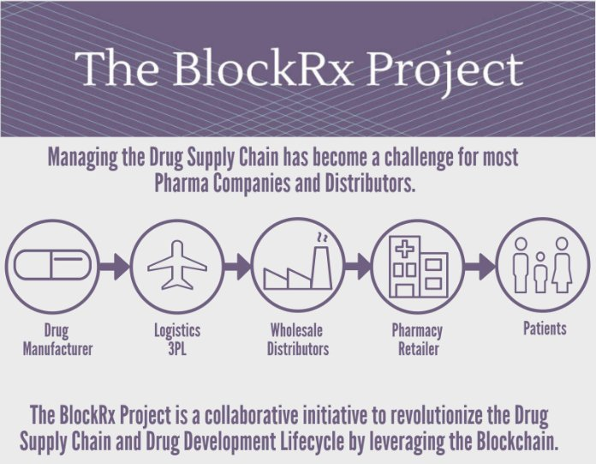
Drug Supply Chain and Drug Development Lifecycle

Slide 31
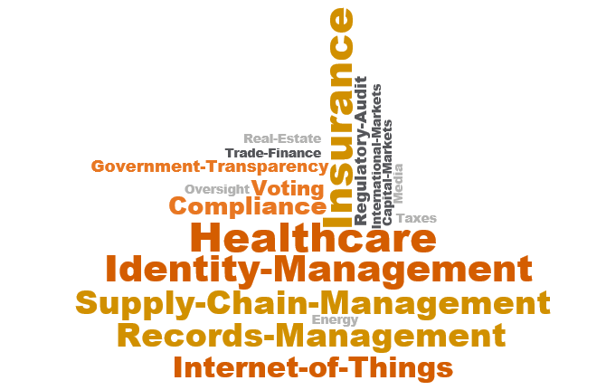
Other Potential Uses…

Slide 32
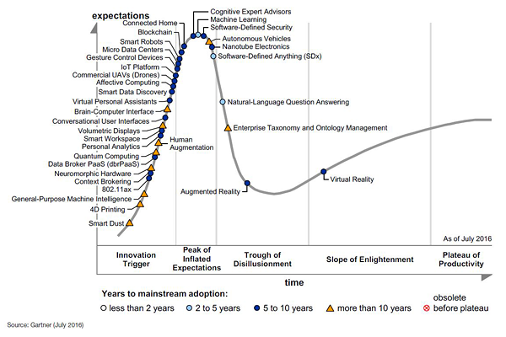
Market Trends

Slide 33
Q & A

Slide 34
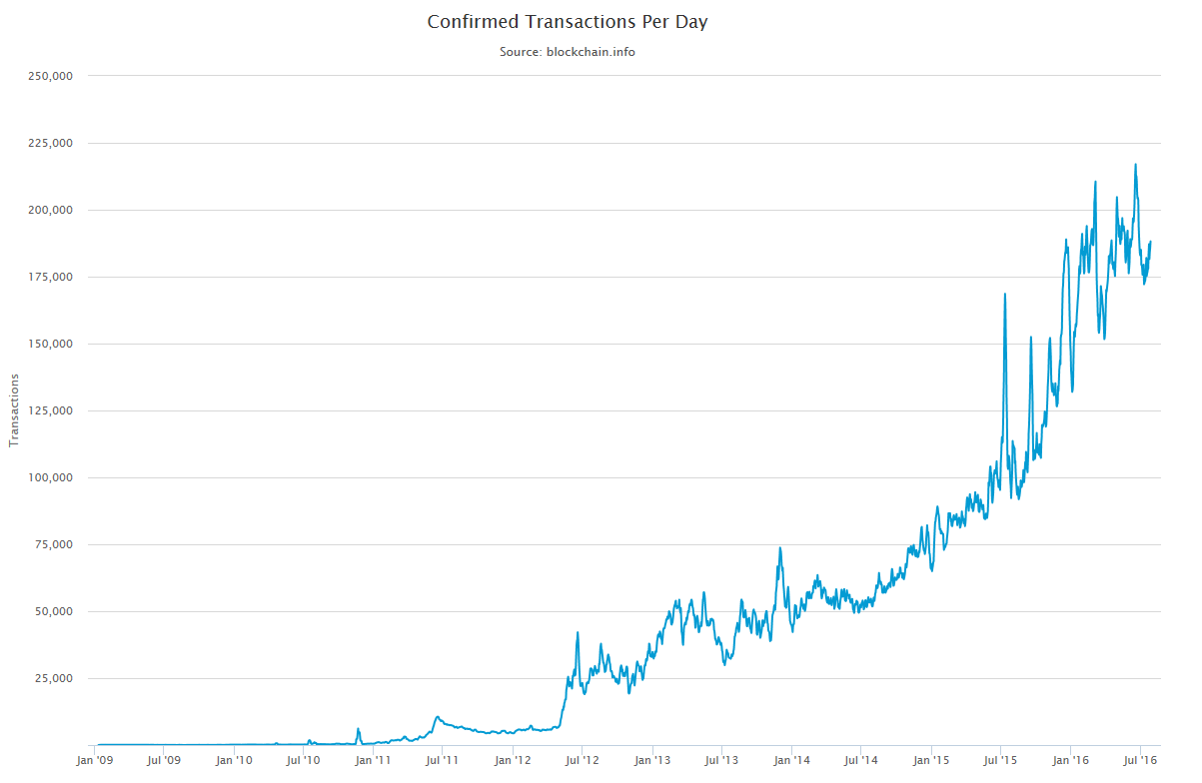
Bitcoin’s Accelerated Growth

Slide 35
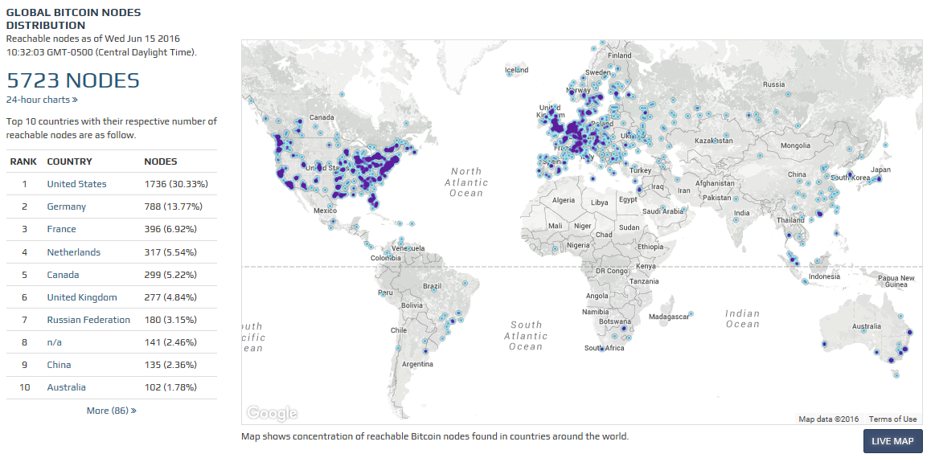
Global Reach of Bitcoin

Slide 36
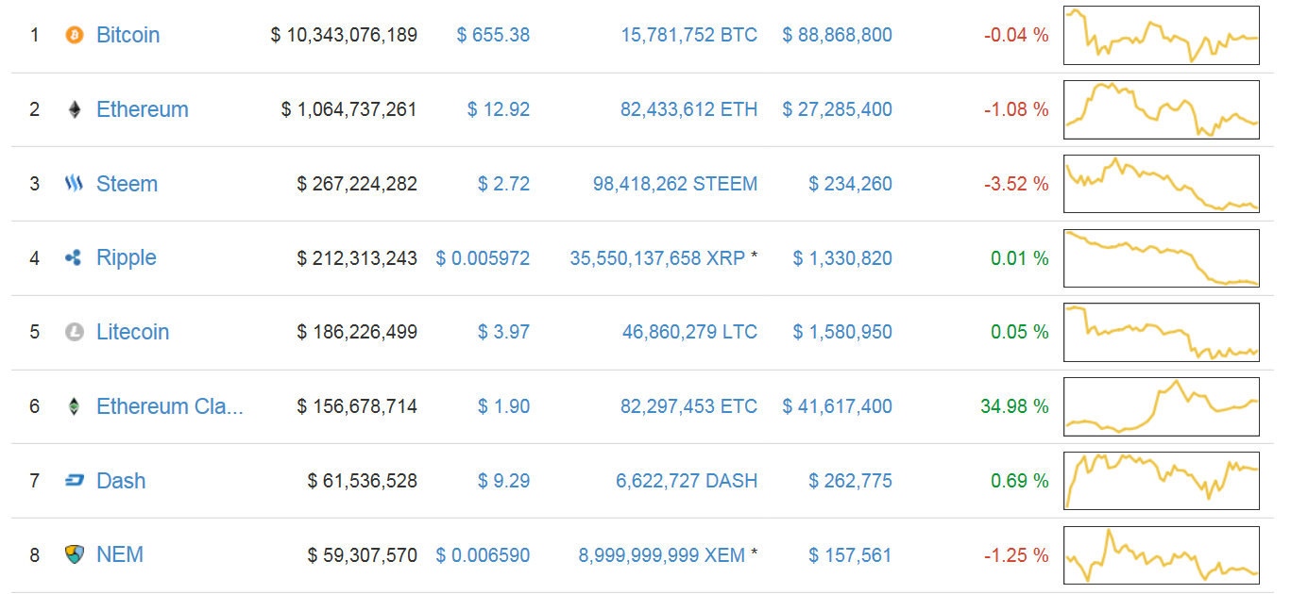
Bitcoin has Inspired 732 Virtual Currencies

Slide 38
Microsoft Project Bletchley
Attribute | Result
Type of Solution | Choose any blockchain platform on provided infrastructure (Custom Combination of best fit technology)
Type of Blockchain | Private, Consortium (members only permissioned network)
Readiness | Alpha
Features | Blockchain Middleware & Cryptlets; Allows secure interoperation between consortium blockchains; Enhances the security and utilization of Smart Contracts. Identity and key management.
Architecture | Improved flexibility and scalability due to added features, deployment tools, Smart Contracts
Security | Blockchain Middleware and Cryptlets (HTTPS/SSL)
Notable Use Cases | R3 REV & 40+ Banks (Barclays, Credit Suisse and J.P. Morgan Chase & Co.,) processing transactions without traditional third-party clearing houses
Viability | Azure as a blockchain fabric, Technology leader in the blockchain services
Applicability | Can be used in any industry; Built around enterprise needs
Strengths:
Azure
Additional Enterprise Features
Cryptlets create a “watermark” for transactions/smart contract and secures utilization of external data
Weaknesses:
Not yet in production

Slide 39
IBM High Security Business Blockchain/Z Systems
Attribute | Result
Type of Solution | Member of Linux Foundation’s Hyperledger Project which is a collaborative effort to create a blockchain for business
Type of Blockchain | Private, Permissioned, and Public
Readiness | Beta
Features | Enterprise solution(z-systems), Smart Contract, Higher levels of security, IBM Bluemix Garage
Architecture | Z Systems : built for scale and integration Scalable and Flexible, Crypto-optimization
Security | Four validating nodes and certificate authority; protection from host administrators; High Evaluation Assurance Level protection between environments; Federal Info Processing Standards
Notable Use Cases | Fabric for Hyperledger
Viability | IBM Bluemix Services
Applicability | Highest Healthcare FIPS
Strengths:
Bluemix Cloud services
Enhanced security features
Step-by-step project development and deployment walk-through (Garage)
Weaknesses:
Still in beta

Slide 40
Microsoft Blockchain as a Service
Attribute | Result
Type of Solution | Choose any blockchain platform on provided infrastructure (very open)
Type of Blockchain | Private, Permissioned, and Public
Readiness | Production, Always adding more platforms & templates
Features | Smart Contracts, Advanced data management and analysis capabilities like Cortana Analytics (machine learning), Power BI, Azure Active Directory, O365 and CRMOL
Architecture | Azure provides an open, flexible, scalable platform; growing rapidly
Security | Blockchain digital signature technology*
Notable Use Cases | Ethereum Blockchain as a Service, ConsenSys, John Hancock (insurer) to detect money-laundering w/ POC pilots, Fidor running its online retail platform
Viability | Supported by Microsoft Azure Cloud Services and Computing
Applicability | Ability to integrate and analyze information collected from virtually any source, including medical devices ; Provide fast, secure, authenticated access to personal medical records
Strengths:
Leverages Azure Cloud Computing and its features
Weaknesses:
No specific enterprise solution
Notes:
Surrounding capabilities like Cortana Analytics (machine learning), Power BI, Azure Active Directory, O365 and CRMOL can be integrated into apps launching a new generation of decentralized cross platform applications.

Slide 41
Blockchain Architecture Taxonomy
Examples:
Transactions
Trusted External Data Source
Work in progress
may trigger
Blockchain
Blocks
Transactions
Smart Contracts
securely links
groups
may trigger
added by
Incentives
Blockchain Stewards
Consensus Protocol
motivated by
trusted through
Examples:
Proof of Work
Federated Byzantine Agreement
Practical Byzantine Fault Tolerance
Proof of Stake
Security Deposit
Examples:
New currency
Transaction fees
Access to data
Examples:
Bitcoin Miner

Slide 42
How does Bitcoin work?
Transaction is proposed to the network
Transaction is checked by computerized accountants
First account to validate receives reward/transaction fee
Consensus rules are evaluated
Transaction is accepted or rejected
Ledgers are updated
Replicated ledger with computer accounting
Block N: Hash BN
TX X: Hash TX
TX Y: Hash TY
Chained in order of occurrence
Issues with Bitcoin “Blockchain 1.0”
Privacy: Ledger is public
Scalability: Ledger is replicated on all nodes
Performance: Validation is compute expensive
Block 1: Hash B1
TX 1: Hash T1
TX 2: Hash T2
~1500 Transactions/Block
Notes:
Blockchain is the public ledger technology used to drive Bitcoin transactions
Eliminates the need for intermediaries by enabling peer to peer transactions
Is highly available by replicating transactions across many networked computers
Tamper-proof through encryption and validation voting within the network
Transparent access to all transactions
Has potential to disrupt many areas:
Financial transactions by replacing intermediaries
Smart contracts that distribute money or other items of value based on events
Identity management such as passports, licenses, credentials
Transfer of anything of value

Slide 43
History
2008: Bitcoin whitepaper published by Satoshi Nakamoto
2009: Genesis block created
2014: Mt. Gox shutdown: double spending of $473M
2015: Microsoft launches Blockchain as a Service
Feb 2016: Eris is 1st Blockchain platform on AWS
June 2016: Ethereum smart contract incident
August 2016:
Bitfinex theft of $63M
Financial and Healthcare Industries require secure Blockchain capabilities
2009: Bitcoin version 0.1 released as open source
2011: Satoshi Nakamoto is “gone for good”
2015: Ethereum is launched
2016: Philips Healthcare forms the Blockchain Lab
Feb 2016: Hyperledger Project is announced
2017-2018: Financial Consortiums go into production
“Blockchain 1.0”
Public distributed ledger
Virtual currencies such as Bitcoin
“Blockchain 2.0”
Much faster transactions
Smart Contracts
“Blockchain 3.0”
Private Consortiums
Security and Privacy
Positive
Negative
Neutral

Slide 44
But Is Blockchain 1.0 and 2.0 Secure?
The jury is still out, will require more detailed research if even applicable to health care
Strong SHA-256 ECDSA cryptographic hashing can ensure integrity of transactions
Validation is a computational intensive proof-of-work competition
Bad actors could theoretically exploit the network:
Increase chances of winning the competition by controlling enormous CPU power
“51% attack” can be used to flood the validation process
Poisoned nodes could isolate network and enable corrupted long chains
Spamming transactions
Attacking all users
Sybil attack [refusal to relay all blocks-disconnections, transaction filtering- zero confirmations and Tor can allow for a timing attack and time drift]
The Ledger is public [so are the ledger’s IP addresses]
Good for transparent auditing and transaction monitoring
Bad for privacy and security in sensitive industries such as health care

Slide 45
Recommendations
Conclusions
Explosively rapid adoption of the Blockchain concept, but not of the technology… yet
Blockchain should not be used for healthcare today due to security and privacy issues
Gartner: “Thorny questions about the very nature of Blockchain technology and public versus private models will slow adoption efforts by insurance CIOs and contribute to a high rate of failures among early efforts”¹
Questions
Explore Optum as the global private healthcare Blockchain platform supplier?
Next Steps
Explore collaboration with Microsoft, Phillips Blockchain Lab and Open Ledger Project
Bring the technology in house for evaluation for funded PoC for deeper assessment
Fund collaboration with university-level research into deep security research
¹ What Insurance CIOs Need to Know About Blockchain (Gartner Report G00303129, 18 May 2016)

Slide 46

What about Healthcare?
Start-ups and Initiatives
Gem Health healthcare Blockchain application platform
BitHealth global healthcare identity and records
Philips Healthcare Blockchain Lab
Factom and HealthNautica exploring securing healthcare records
Future Possibilities (2-5 years)
Patient records (replacing PHR and HIE)
A consolidated HIPAA log (replacing Splunk and ELK)
Claims (replacing clearinghouses)
Master Provider Directory
Patient and user identity management

Slide 47
Potential use of Blockchain technology in UHG [Jacob]
Distributed databases of homogeneous information, e.g. medical records, claims, provider, etc.
Information chains:
Between homogeneous business partners, e.g. PBMs. Adjudication systems, etc.
Between partners with similar data in different formats using ESB transformation technology, e.g. HIE
Heterogeneous chains that assemble number of homogeneous chains, e.g. a chain that connects chains of provider, medical claims, pharmacy claims, medical records
Exposing Blockchain-as-a-Service (BaaS) with proper PHI/PII security for internal and external customers using Optum Cloud
Bridging Blockchain as operational data and BDPaaS as analytical data

Slide 48

Blockchain implementation Options [Jacob]
Technology Options:
Public Blockchain-as-a-Service (BaaS)
Amazon
Microsoft Azure
Blockchain vendor products
Chain Inc., Eris Industries Ltd., Ethereum, …
Intel
IBM
Microsoft
Blockchain open source platforms
Steem
Openchain
MIT Enigma
Deployment Options:
Openshift
Docker
VM

Slide 49
What Security Questions Do We Have? [Phil]
Privacy: How are block headers and transactions secured in a permissioned Blockchain [private vs. public]?
Block Integrity: Can a more advanced verification/validation scheme reduce data integrity risk?
Chain Integrity: Can a DoS or DDoS attack introduce interruptions or availability issues in the Blockchain?
Hardening: Can the current cryptography be enhanced to make it more difficult to break?
Impersonation: Can rogue miners impersonate valid miners and corrupt or invalidate the blockchain?
Validator Non-repudiation: How is the identity of the miner guaranteed?
Immutability: Can permissioned Blockchains be anchored securely ensuring that the blockchain leger maintains its integrity? Anchoring refers to permissioned Blockchains periodically submitting hashes of the block headers into a Permissionless Blockchain. Anchoring strengthens the immutability guarantee of the permissioned Blockchain.

Slide 50
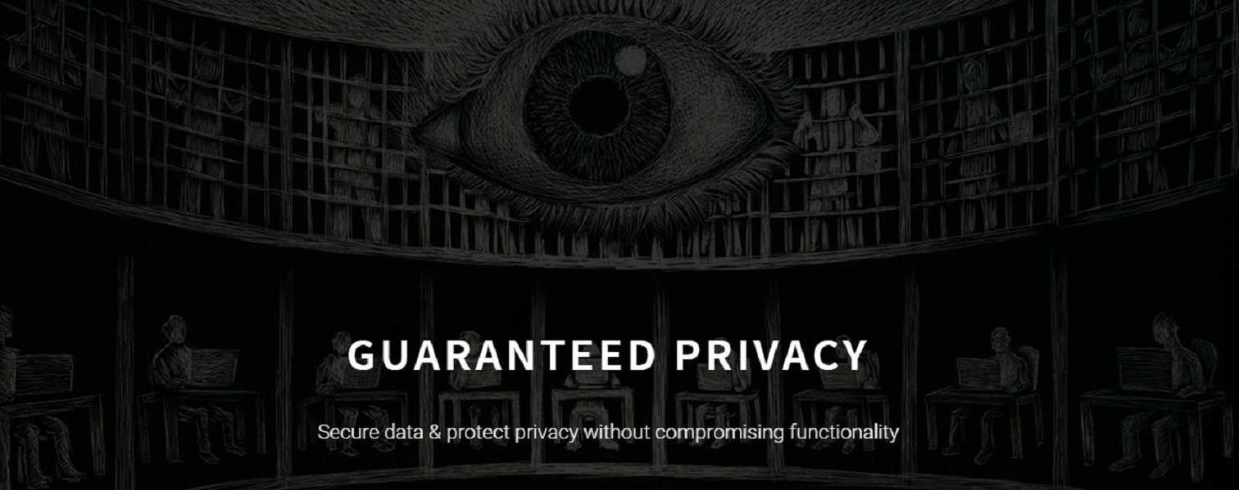
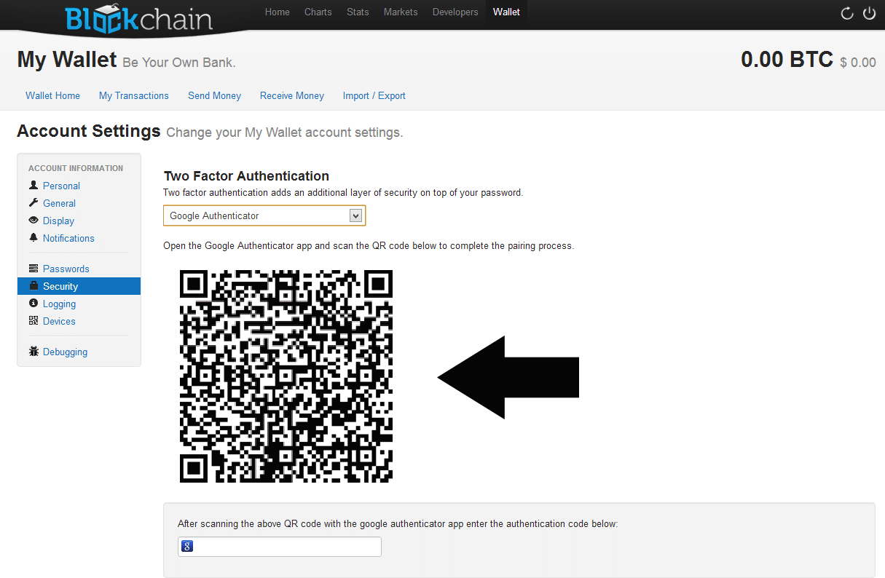
What Potential Security Solutions Exist Today In Blockchain? [Phil]
The MIT Media Labs Enigma Project & Blockchain My Wallet Google Integration

Slide 51
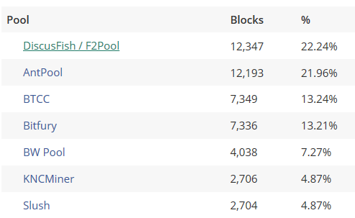
Is the 51% Attack Possible?
Bitcoin miners are in pools
Top miners have won the majority of all block validation contests

Slide 52
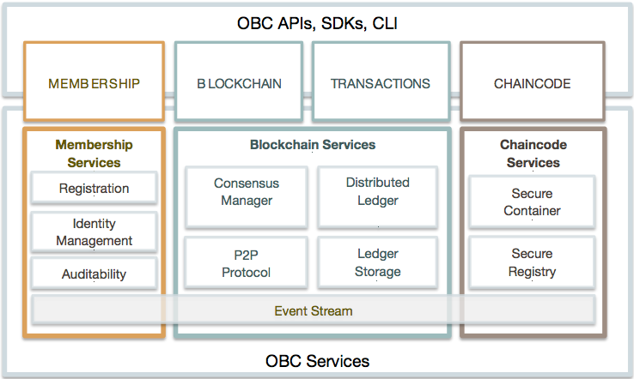
Open Blockchain (Open Ledger) [Jacob]
Open Blockchain architecture is aligned in three categories - Membership, Blockchain and Chaincode:
Membership services manages identity, privacy and confidentiality on the network.
Blockchain services manage the distributed ledger through a peer-to-peer protocol, which is built on HTTP/2.
Chaincode services are a secured and lightweight way to sandbox the chaincode execution on validating nodes.
Open Blockchain includes the REST and JSON RPC APIs, events, and an SDK for applications to communicate with the network.

Slide 54
Blockchain Challenge
How can Blockchain and Smart Contracts be used to improve healthcare?
First Place
Team Name: Chain Gang
Team Members: Donna McCart, Susan Yost, Melanie Zierer, Rick Target, & Alexander Romano
Use Case Area: Provider Demographics
Second Place
Team Name: AAA Chain Gang
Team Members: Alex Mycio, Amelia Dull, & Danielle Martin
Use Case Area: Rx Fraud
Third Place
Team Name: UnBlock
Team Members: Piyush Gupta, Anshuman Sinha, Sanjay Singh, Devikiran Ramadas, & Love Hasija
Use Case Area: Rx Counterfeiting

Slide 55
Blockchain Roadmap
Identify Product Opportunities
Establish Use Cases and Rationale
Implement Proofs of Concepts & Establish Reference Architecture
Initial Technology Assessment
Evaluate Blockchain Platforms
Engage Universities and Industry
Internal Collaboration with Emerging Technology and Advanced Technology Center
June
July
August
September
October
November
December
2017

Slide 56
Blockchain Tactical Next Steps
Informal brainstorming and education
Innovation Challenge (9/1)
Fusion Session @ Fenway (9/7-9/8)
Side by side evaluation (8/10)
12 options considered
5 major considerations
Establish Use Cases and Rationale
Evaluate Blockchain Platforms
Select use cases and platform
Implement proofs of concept (TBD date)
Funding and Resources (TBD)
Collaborate with Emerging Tech and ATC
Design reference architecture
University collaboration (ongoing)
Financial Blockchain Conference (7/28)
Industry and consortium engagement
NIST Healthcare BC Workshop (9/26)
Distributed Health Conference (10/3)
PoCs and Reference Architecture
Engage Universities and Industry

Slide 57
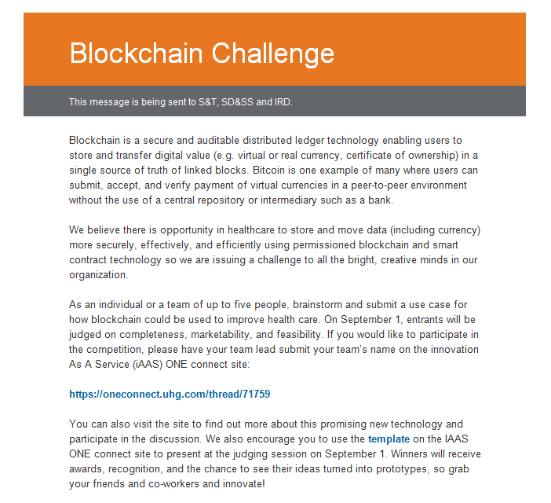

Slide 58
Blockchain Challenge
How can Blockchain and Smart Contracts be used to improve healthcare?
First Place
Team Name: Chain Gang
Team Members: Donna McCart, Susan Yost, Melanie Zierer, Rick Target, & Alexander Romano
Use Case Area: Provider Demographics
Second Place
Team Name: AAA Chain Gang
Team Members: Alex Mycio, Amelia Dull, & Danielle Martin
Use Case Area: Rx Fraud
Third Place
Team Name: UnBlock
Team Members: Piyush Gupta, Anshuman Sinha, Sanjay Singh, Devikiran Ramadas, & Love Hasija
Use Case Area: Rx Counterfeiting

Slide 59
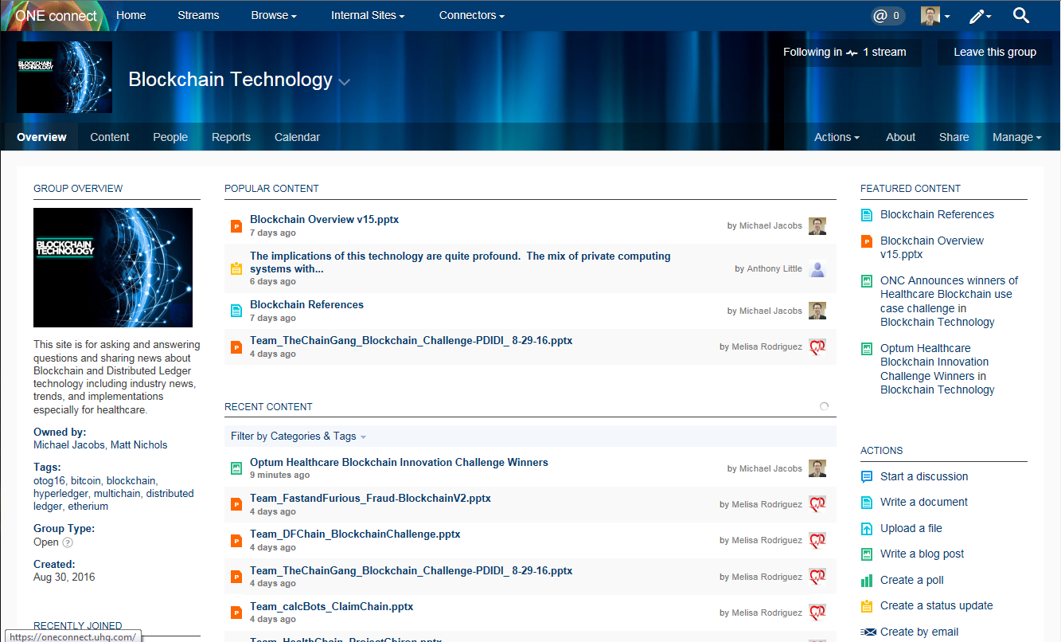
Blockchain Technology OneConnect

